Slide 1
Introduction to this Course
Sungjoon Choi

Slide 2

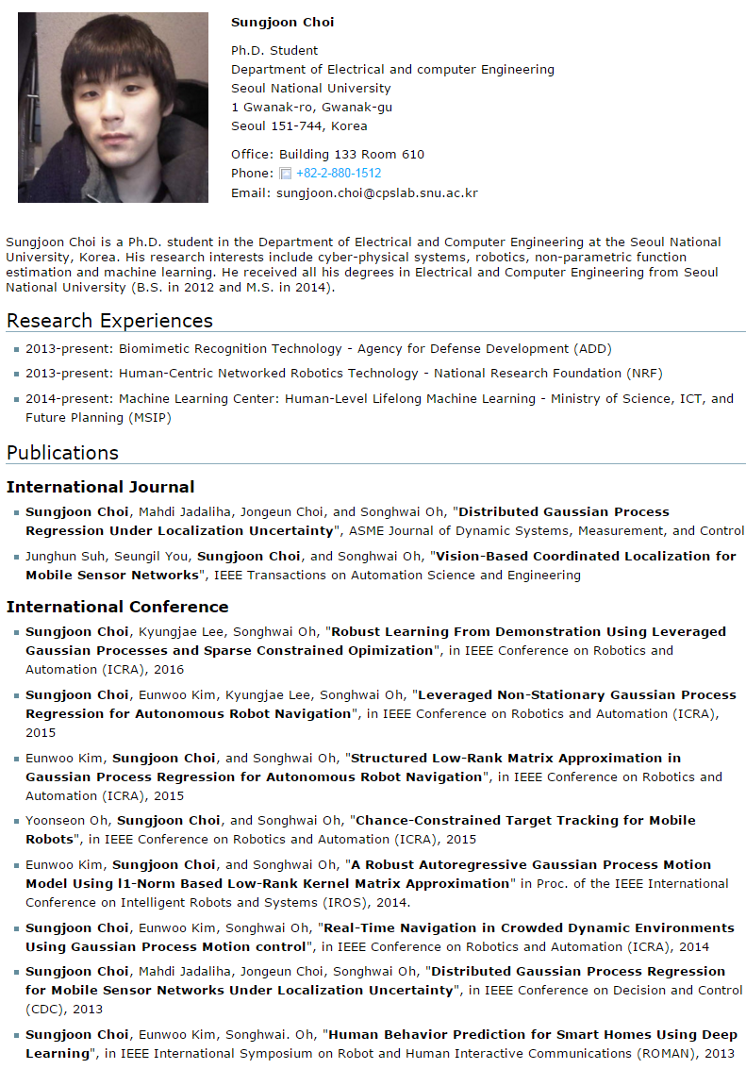
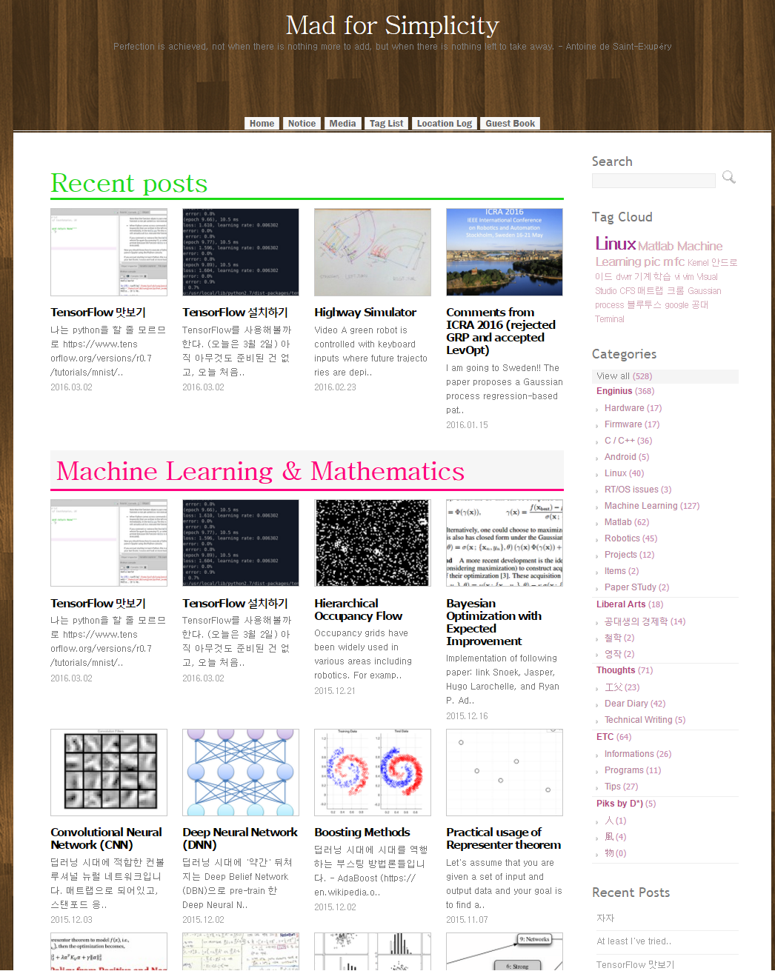
About me
Notes:
I am a graduate student
Yes I am a graduate student
I also run a blog

Slide 3
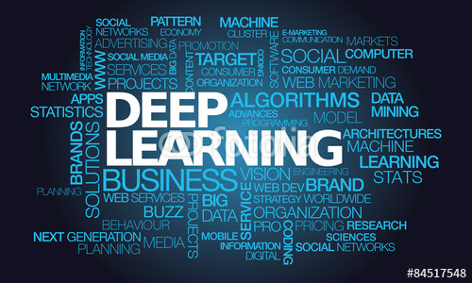

About this Course
딥 러닝
이미지 프로세싱
입문

Slide 4

Deep Learning?
RNN / LSTM
CNN
ANN
RBM
Notes:
What is deep learning?
We will find out

Slide 5
To tell the Truth..
Notes:
To tell the truth, Too many information are flooding on web
Almost all the code and presentation I will show is already on web.

Slide 6
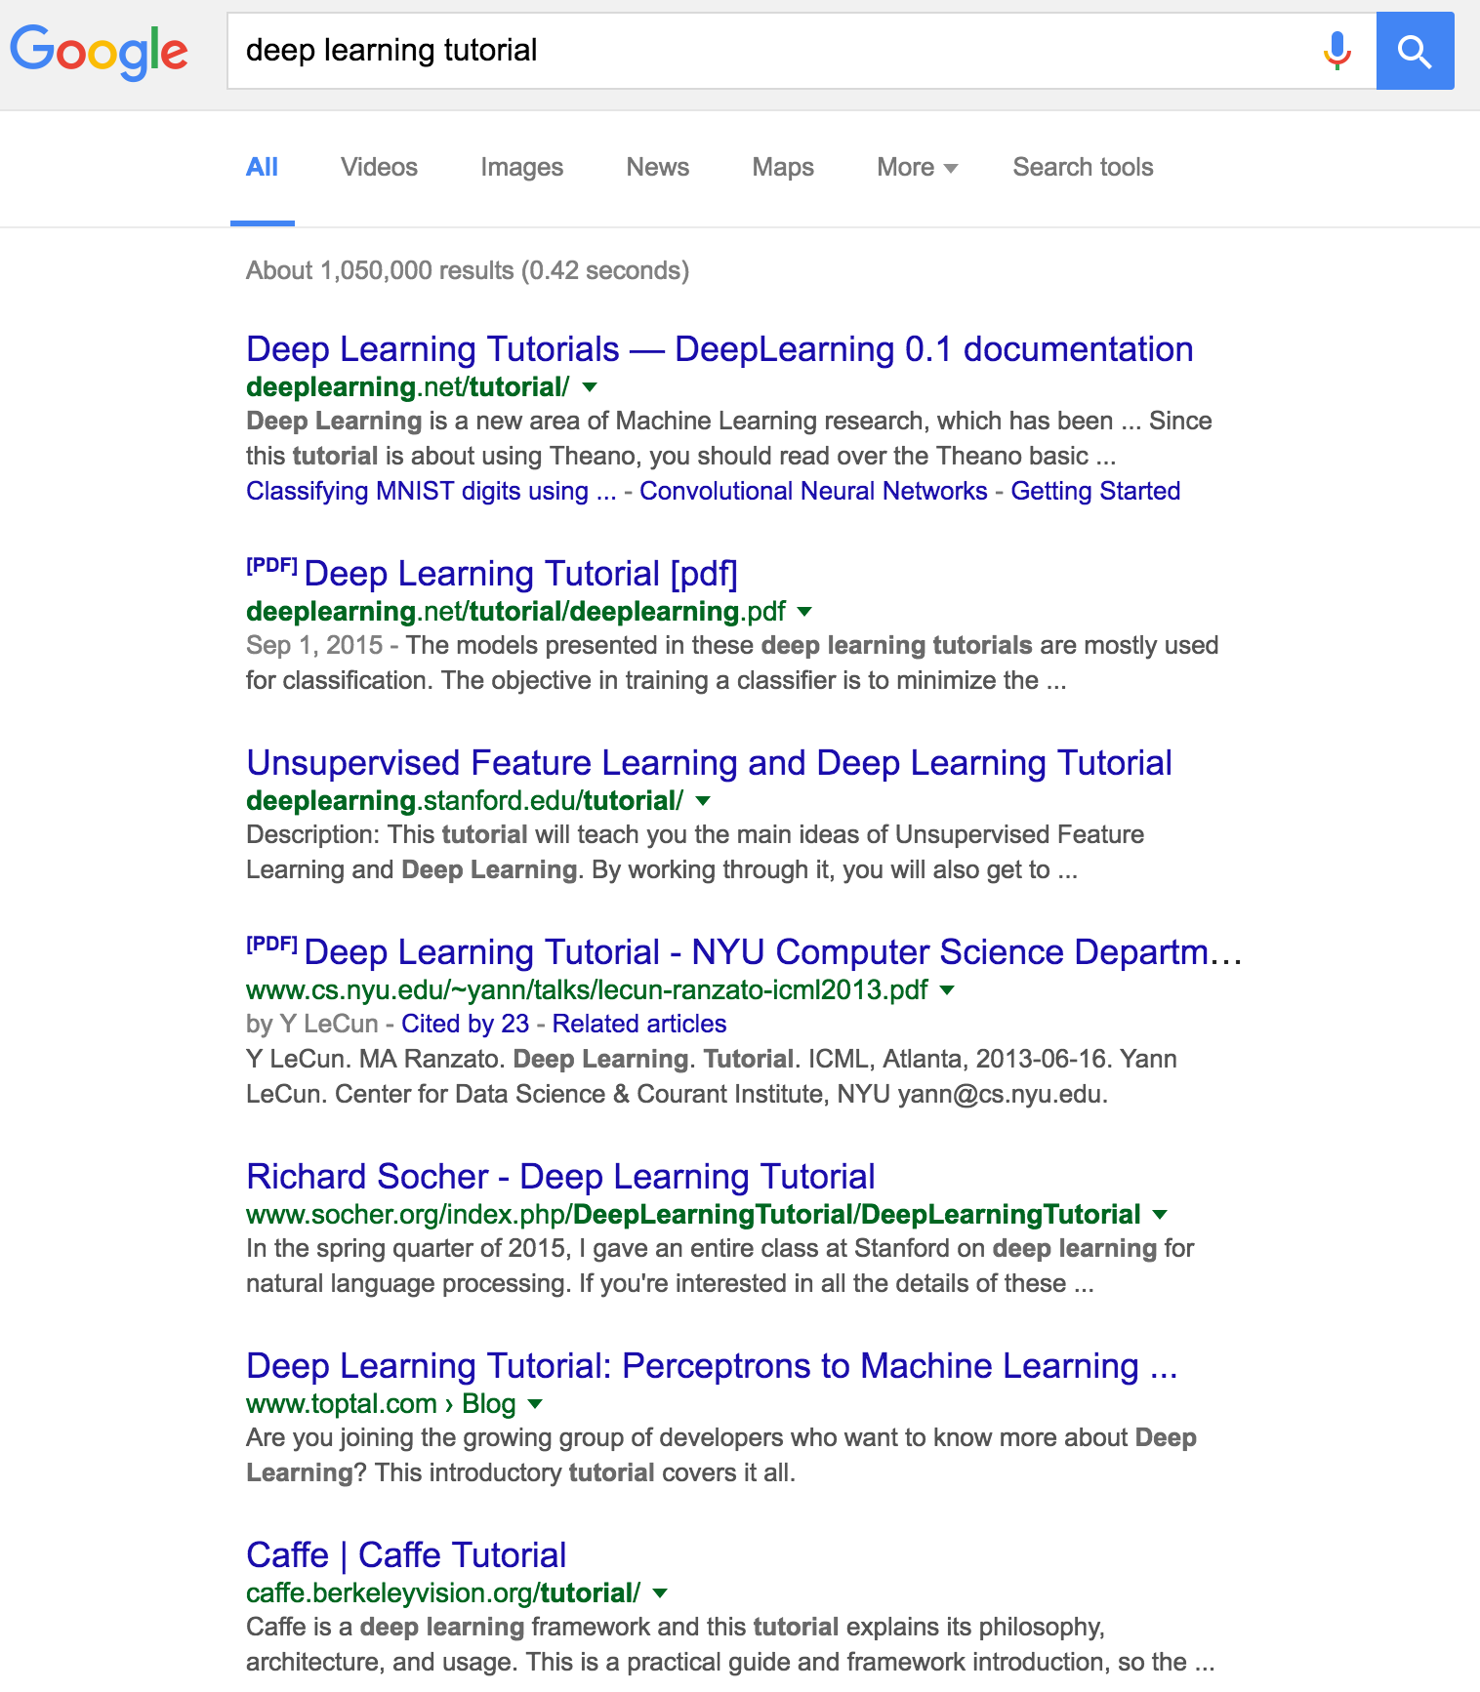
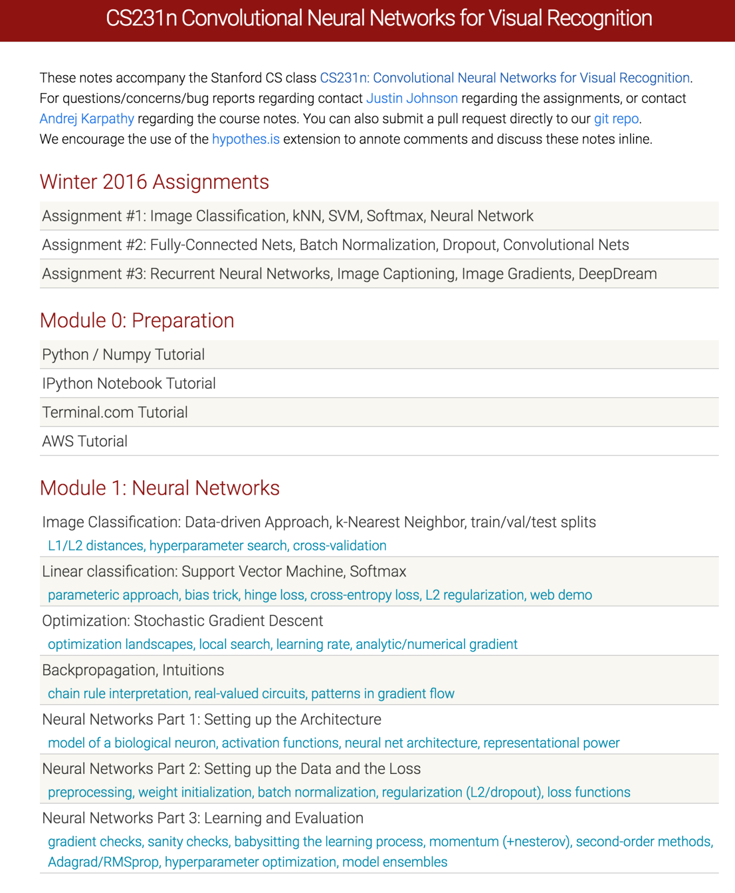
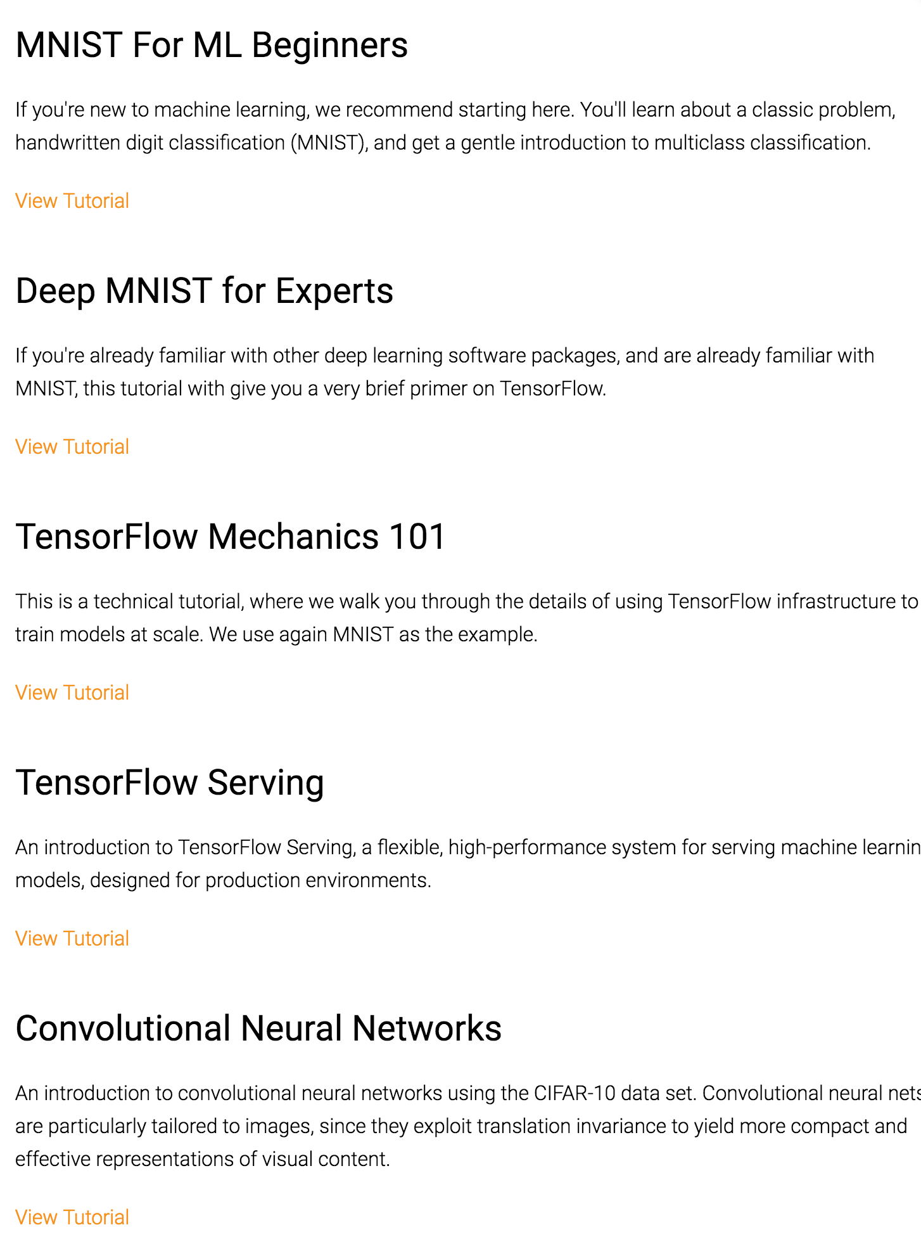


Notes:
..
So, What’s the point of listening to this course?
am I useless?
..
I DONT THINK SO!

Slide 7
My job is to,

Slide 8
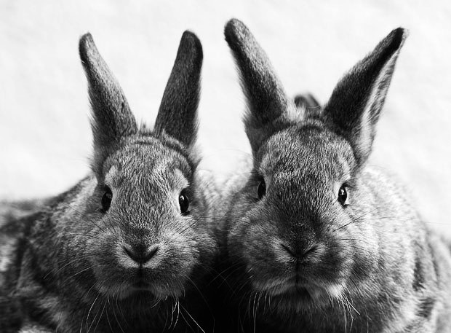
Goal of the Course
Practical Implementation Technique
Deep Learning
Theories
Notes:
Theories
+
Practical coding skills

Slide 9

Introduce Yourself
Notes:
Introduce Yourself
Don’t be shy

Slide 10
Grouping
Notes:
This is not a competition!

Slide 11



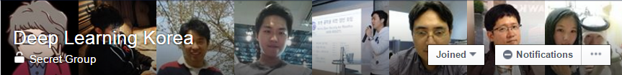

Make Friends in SNS
?

Slide 12
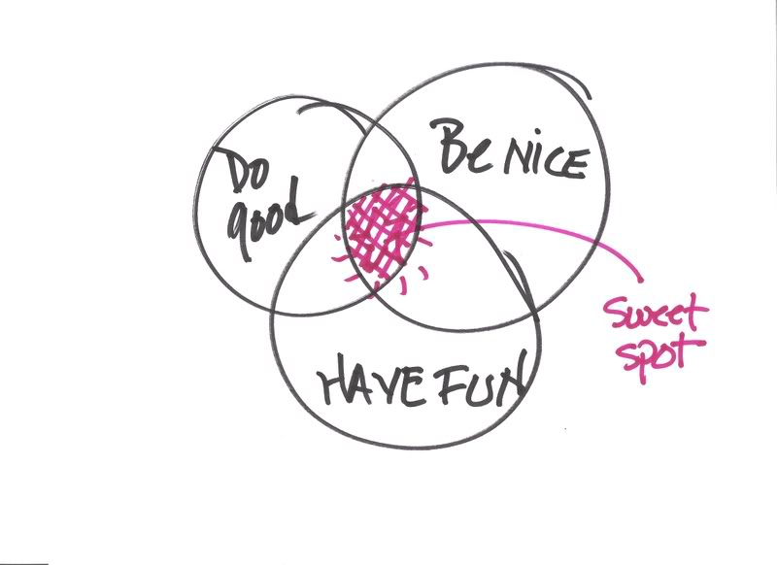


Most Importantly,

Slide 13


Questions, Suggestions?

